Slide 1

Biography Project
Conducting Research: flipped lecture

Slide 2
For class tomorrow….
Be thinking of historical figures you wish to learn more about.
We will break off into groups to discuss these figures.
Think about questions you wish to ask about these figures.
We will answer these questions by researching on www. biography.com.
We will create graphic organizers to organize our thiughts from readwritethink.org

Slide 3
An example of the process:
I wish to learn more about…..
Abraham Lincoln
What do I wish to learn about Abraham Lincoln? Example: What was his childhood like?
    What were his parents’ names?
    Where was he born?
  In class, you will discuss with your group the questions you have regarding your historical figure and other classmates’ historical figures.
  Write down your research questions as you discuss with your group.

Slide 4
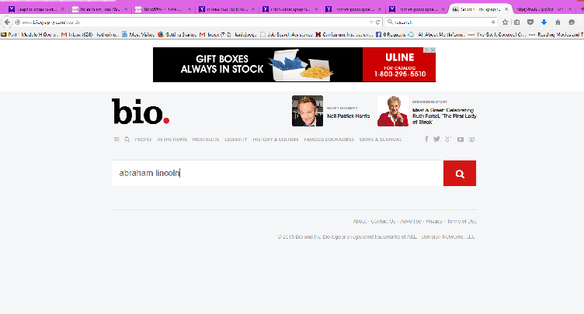
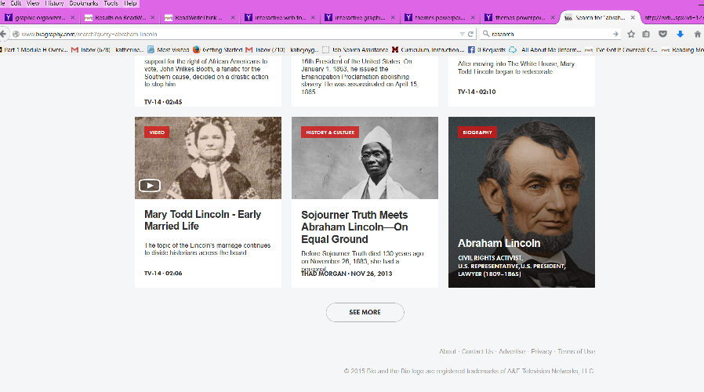
After I ask questions…
I will visit Biography.com
I will type the name of my figure into the search box.
By looking through the search results, I will find a textual biography of my historical figure.
By skimming the biography, I can find the answers to my questions.

Slide 5
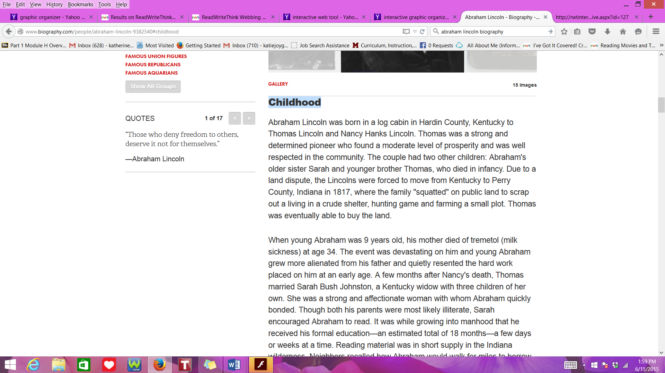
For example…
On the biography.com website, I search for questions regarding Lincoln’s childhood.
I find a heading entitled “childhood” and skim the passage for the answers to my questions
  What were his parent’s names?
  Where was he born?

Slide 6
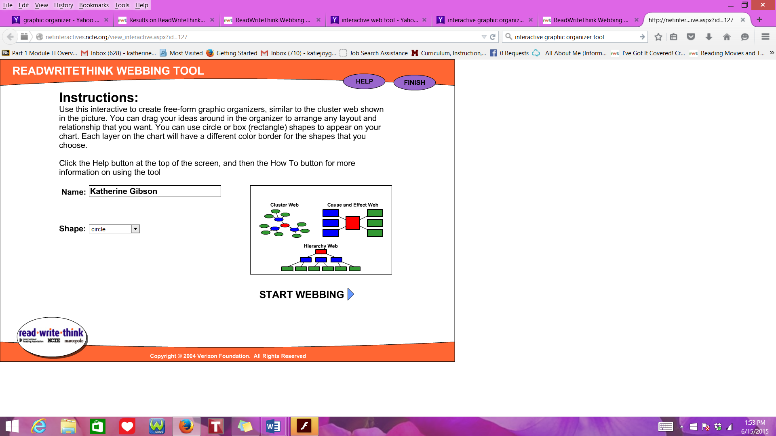
Graphic organizer
I will utilize a graphic organizer from READWRITETHINK.ORG
  http://www.readwritethink.org/classroom-resources/student-interactives/readwritethink-webbing-tool-30038.html
  Click the link,
  type name,
  and click what
  shapes you wish
  to use.
  Then click start
  webbing.

Slide 7
Graphic organizer
I will utilize a graphic organizer from READWRITETHINK.ORG
  Use the software to categorize important information and connect related concepts
  For instance, I can compose Lincoln’s life under headings(my questions) and subheadings (answers found).

Slide 8
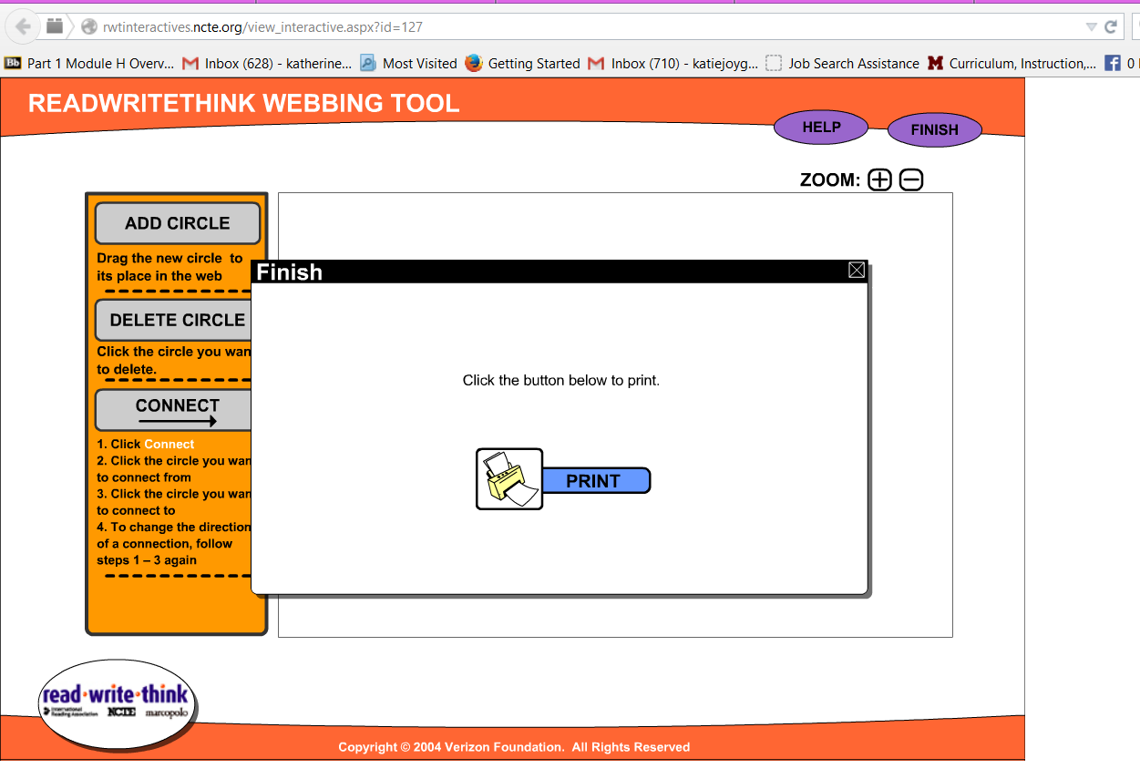
After you are done in class tommorrow, print out the graphic organizer
  Do this by clicking finish then print
We will prepare oral presentations
on our biographies in future class
periods.

